Slide 1


Product Overview

Slide 2

Disclaimer
This presentation is confidential and is intended, among other things, to present a general overview of Zoho's ("Zoho") products and services. This presentation is provided for informational purposes only. The contents are not to be reproduced or distributed to the public or press. While the information in this
presentation is believed to be accurate and reliable, Zoho makes no representation
regarding, and assumes no responsibility or liability for, the accuracy or completeness
of, or any errors or omissions in, any information contained herein.

Slide 3
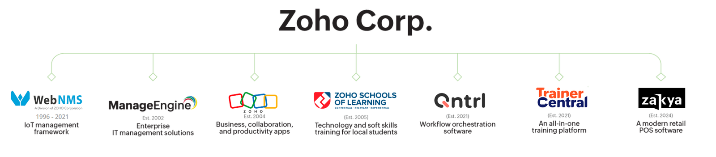







Slide 4
ManageEngine
A bootstrapped, private, and profitable company
20+
280,000+
120+
years in the
industry
organizations across the globe use our products
products and free tools for
IT management
4,500+
190
ManageEngine employees
countries served

Slide 5
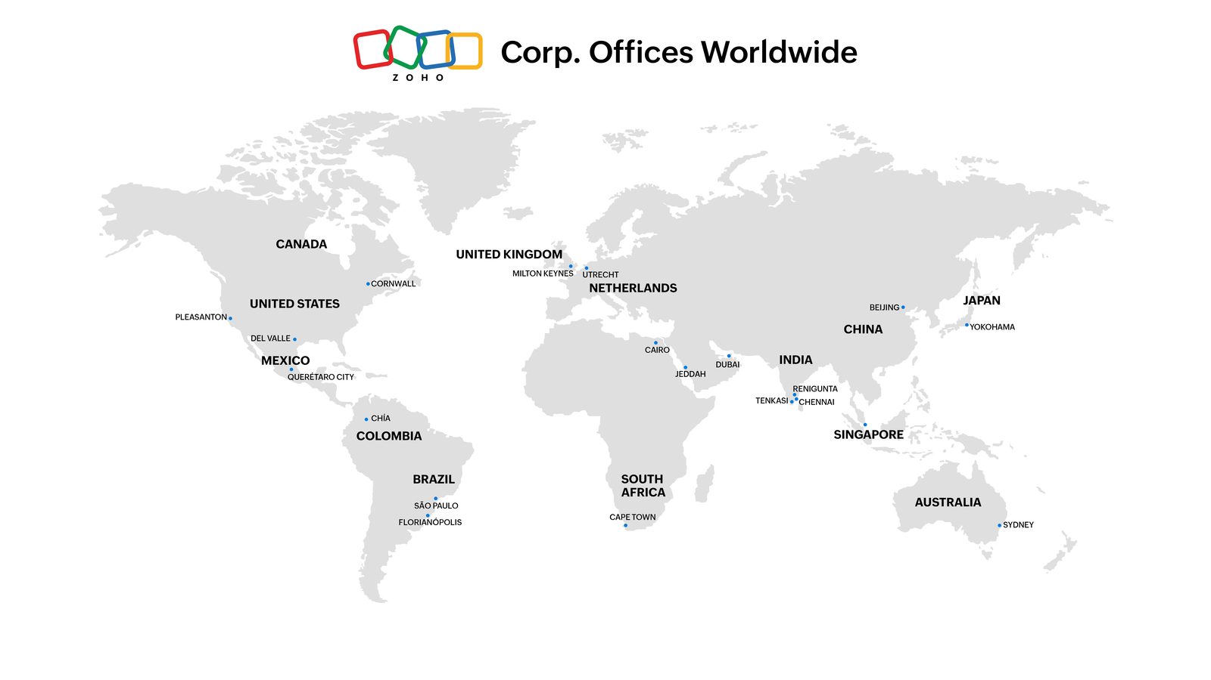

Slide 6
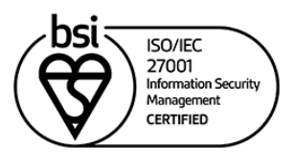
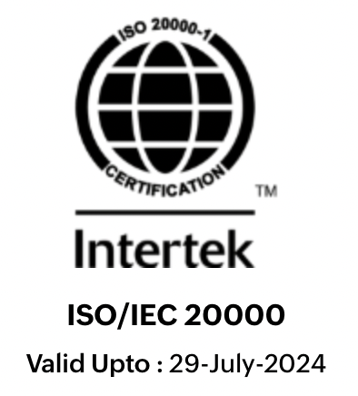

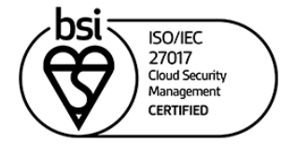


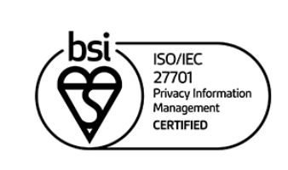
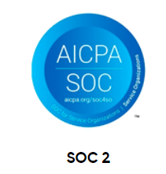

Our certifications

Slide 7

Unified service management
Enterprise and IT service management platform
Single-touch workflow automation for IT and business processes
Custom workflows and lifecycle management for key ITSM
practices
AI-powered virtual assistant and conversational agent
Best practice ITSM framework implementation
IT asset management with a CMDB
Single enterprise service portal for all departments
Advanced reporting dashboards and analytics
Take control of your IT
Unified endpoint management and security
Desktop, server, and mobile device management
OS and software deployment
Automated patch management
Continuous vulnerability assessment and remediation
Web and data security
Endpoint privilege management
Next-generation antivirus
Endpoint analytics and telemetry
Remote monitoring and management
Identity and access management
Identity governance and administration
Privileged identity and access management
AD and Azure AD management and auditing
SSO for on-premises and cloud apps, with MFA
Password self-service and sync
Microsoft 365 and Exchange management and auditing
AD and Exchange backup and recovery
SSH and SSL certificate management
Security information and event management
Unified SIEM for cloud and on-premises
ML-driven user and entity behavior analytics
Advanced threat analytics
Cloud access security broker
Data leak prevention and risk assessment
Regulatory and privacy compliance
Advanced IT analytics
Unified insights into all of IT
AI-driven, self-service advanced analytics
Pre-built contextual reports and dashboards for 200+ IT apps
Automatic report creation through an analytics assistant
Business outcome simulations and predictions
Comprehensive SaaS management
IT operations management and observability
Full-stack observability
Artificial Intelligence-powered IT operations (AIOps)
End-user experience monitoring
Application performance monitoring
Cloud and Infrastructure monitoring
Network performance monitoring
Network traffic and bandwidth analysis
Network security and automation
Network change, configuration, and compliance management
DNS, IP address, and switch port management
Monitor, manage and secure your digital enterprise with ManageEngine
Low-code app development
Custom solution builder
Digital transformation
Citizen development
Business and IT process management
Rebranded mobile apps
Enhance ManageEngine solutions
Available for
Enterprise IT | Managed service providers (MSPs)
as
Self-hosted on-premises
Self-hosted in public cloud (AWS, Azure)
Zoho Cloud-native
Notes:
Good to go, Dhanwant.

Slide 8


www.manageengine.com

